Slide 1
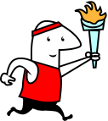
or Body Mass Index
Today we are discussing
BMI

Slide 2
What is a BMI ?
Body Mass Index (BMI) is a number calculated from a person's weight and height. This is a guide which determines if you fall within the Healthy Weight Range

Slide 3
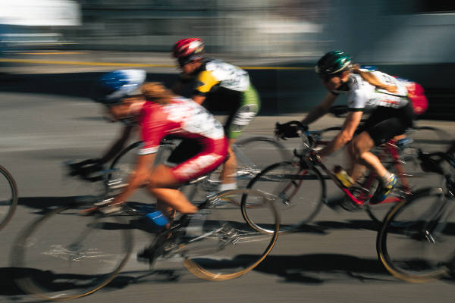
Why know your BMI
Its part of your Fitness Profile
Is a score just like the……..
mile run
Sit ups
Push ups
Sit and Reach
A look at a person’s BMI may suggest that he or she needs to develop an exercise/nutrition program

Slide 4
Where do you fall?
Your BMI is measured by a calculator and places you in one of four categories……….
Ideally we would like to see you all in the
Healthy Weight Range

Slide 5
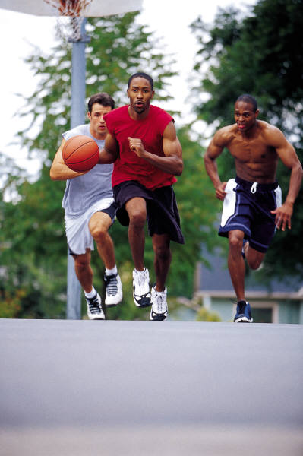
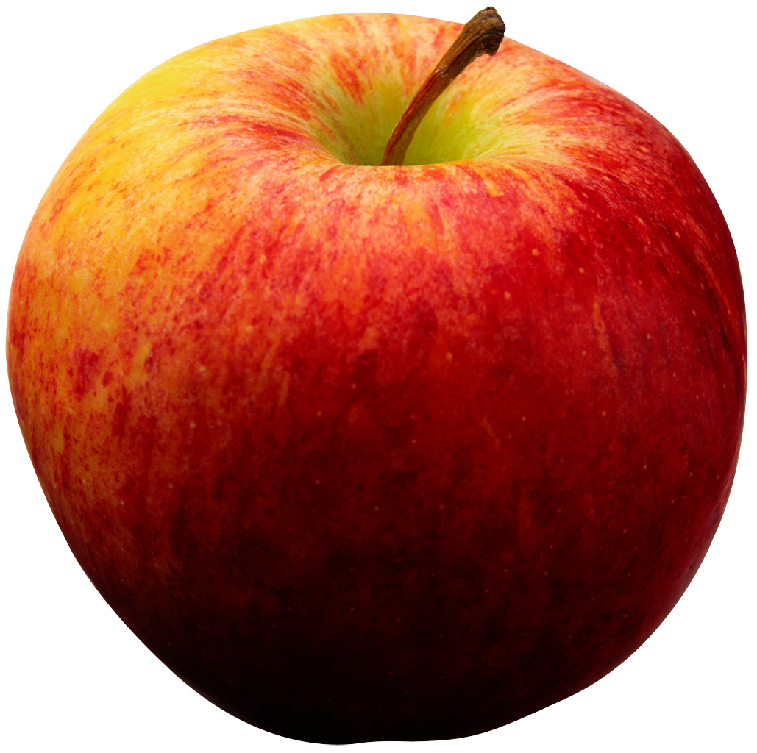
Getting to and staying in the Healthy Weight Range requires that you
Exercise……..
5x per week
40-60 minutes
What activities can you think of that keep you active?
Eat healthy……
What foods/snacks would you consider healthy?

Slide 6
How do I calculate my BMI?
Find the BMI Calculator for Teenagers
www.presidentschallenge.org
“click” Teens Go to Tools to Help
“click” BMI
It will ask you to input
DATE OF BIRTH
BOY/GIRL
HEIGHT
WEIGHT
It will then calculate your BMI
Note……..As a teenager your BMI varies with the changes in your height and weight

Slide 7
Homework Assignment
Go to Seneca Middle School website
Scroll down the menu and click on physical education
Find BMI info sheet and follow the directions
Complete the BMI worksheet
Due March 3rd & 4th during your PE class

